Slide 1



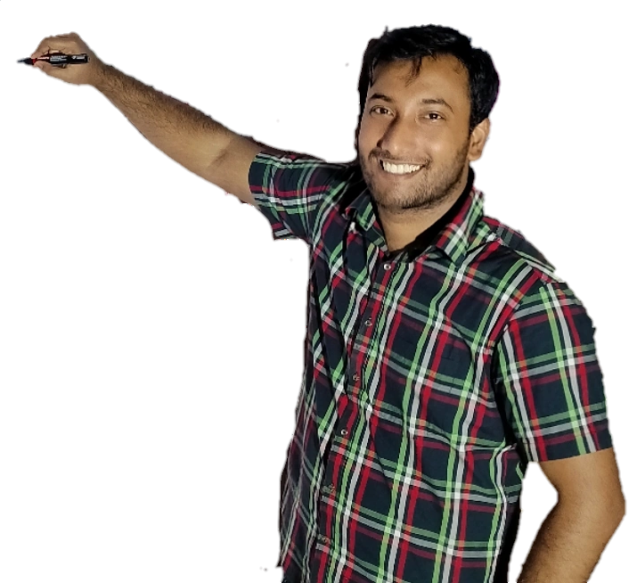
Week-9 (Discussion)
25th Mar, 2025
Deep Learning
Prof. Sudarshan Iyenger
Professor and Head of the Department
Department of Computer Science and Engineering
IIT Ropar
Ayan Paul
PMRF Research Scholar
IIT Kharagpur

Slide 2
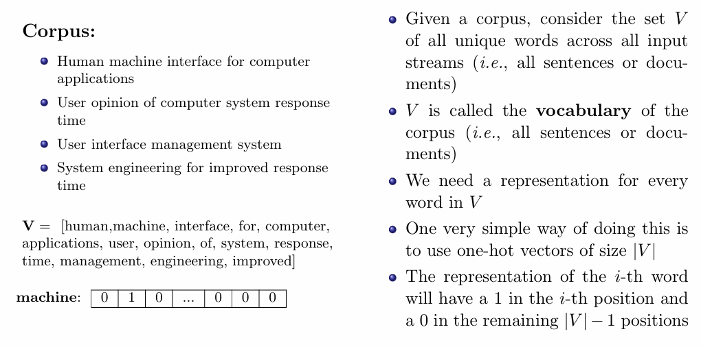
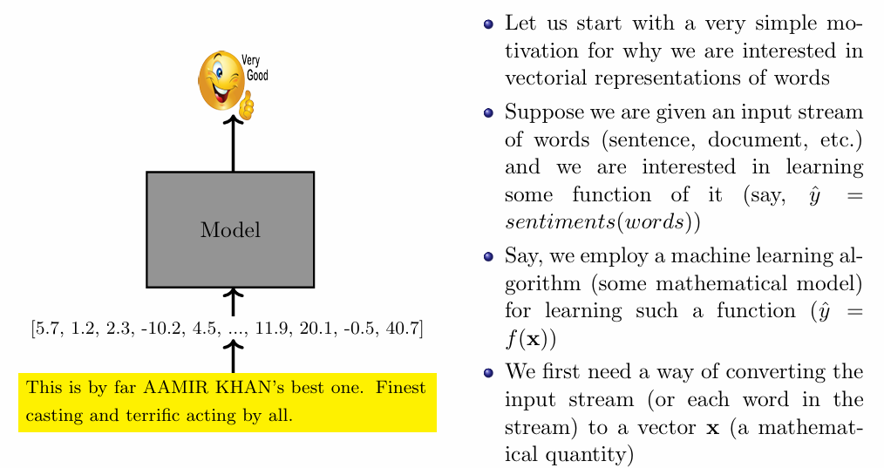
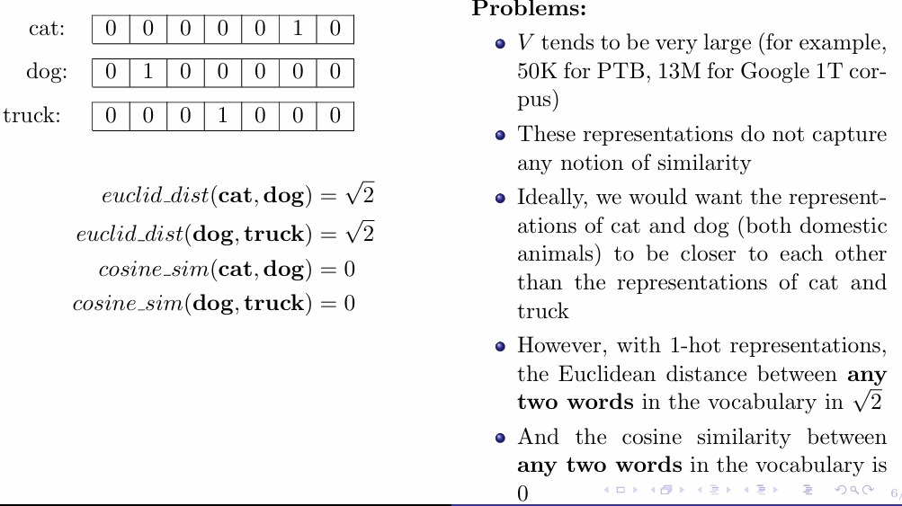
Requirement of Vectorial Word Representation
One-hot representations of words
Limitations

Slide 3
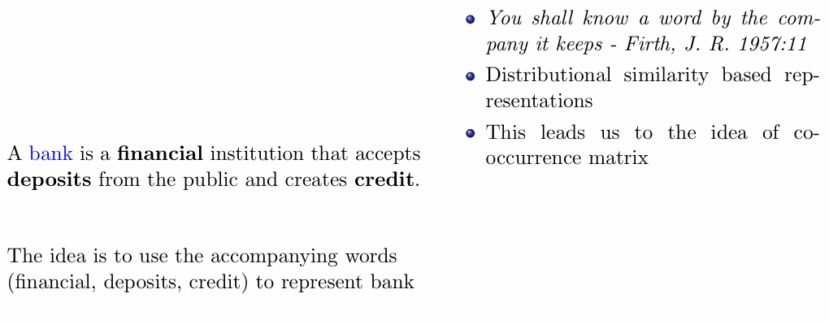
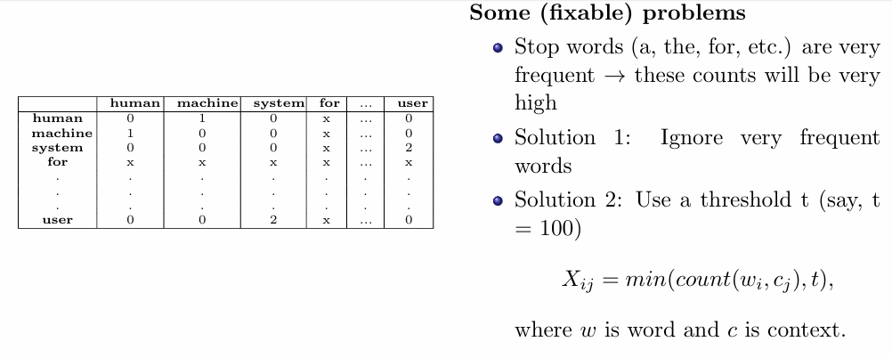
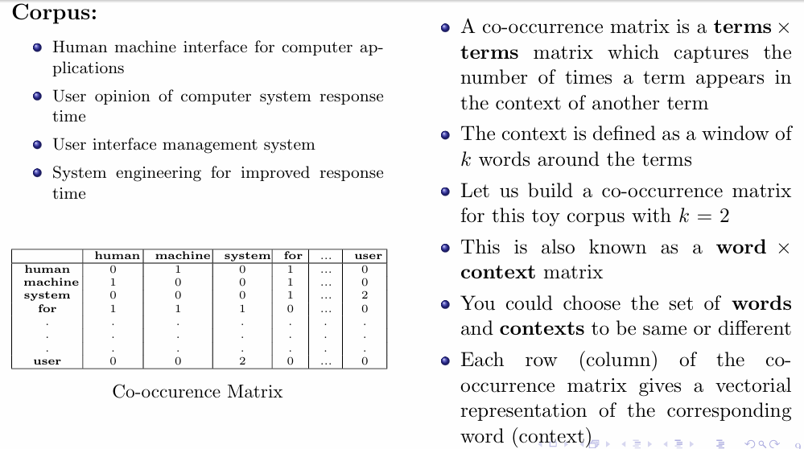
Distributed Representation of words
Limitations (fixable)
Co-occurrence Matrix

Slide 4
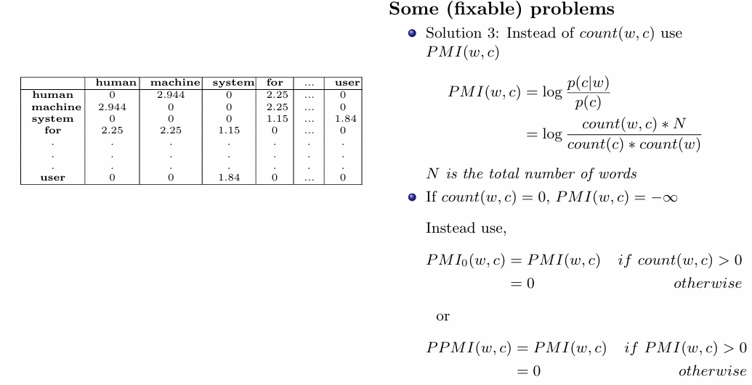
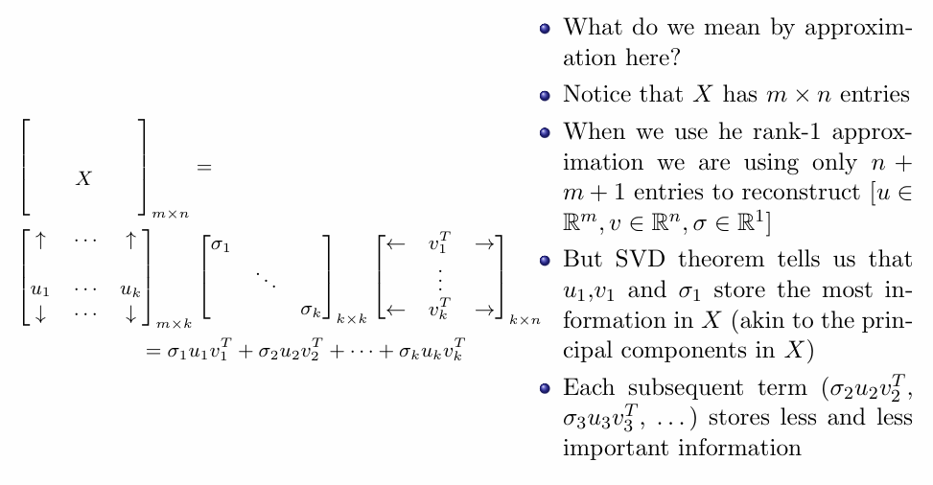
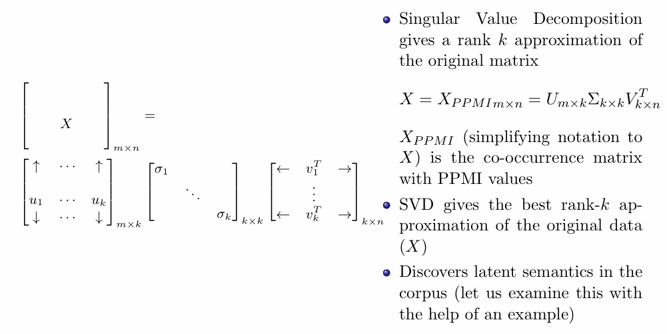
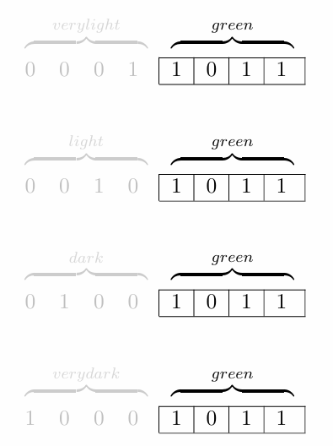
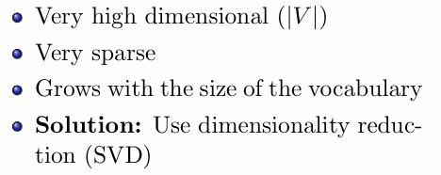
Limitations (fixable) (cont.)
SVD for learning word representation
Limitations (non-fixable)

Slide 5
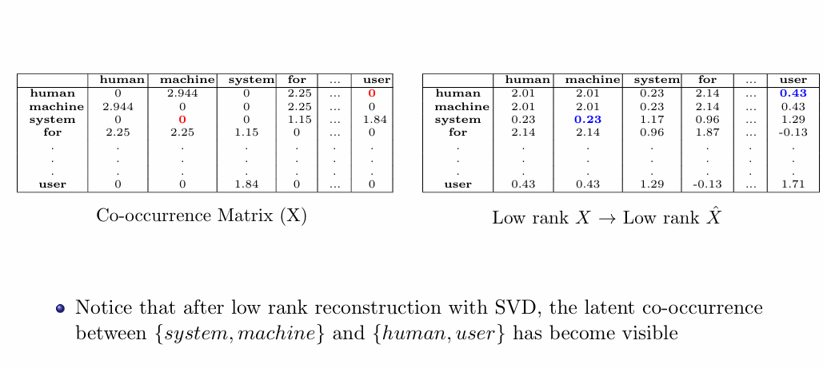
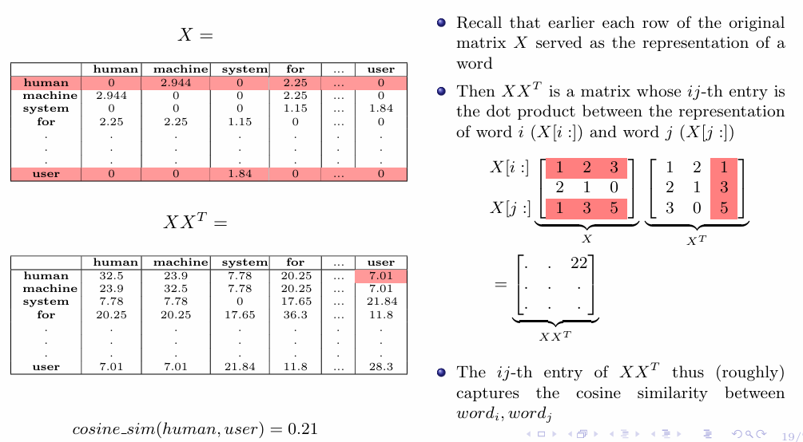
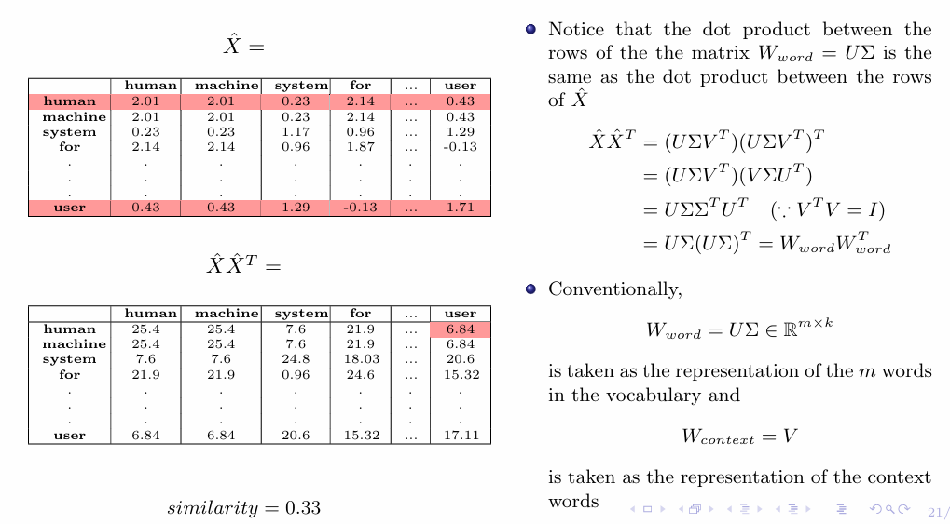

Slide 6
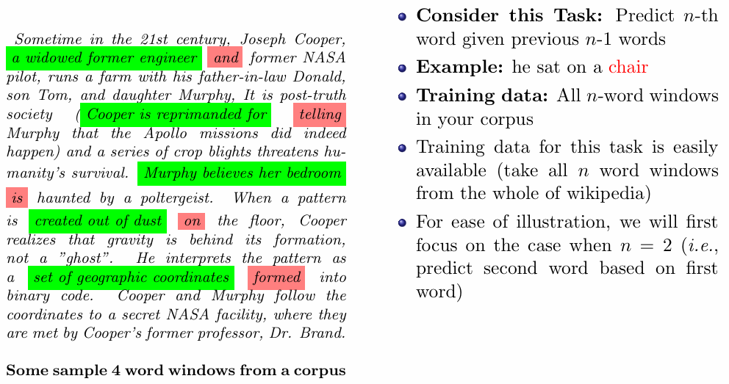
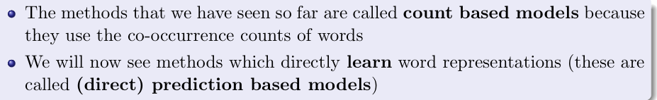
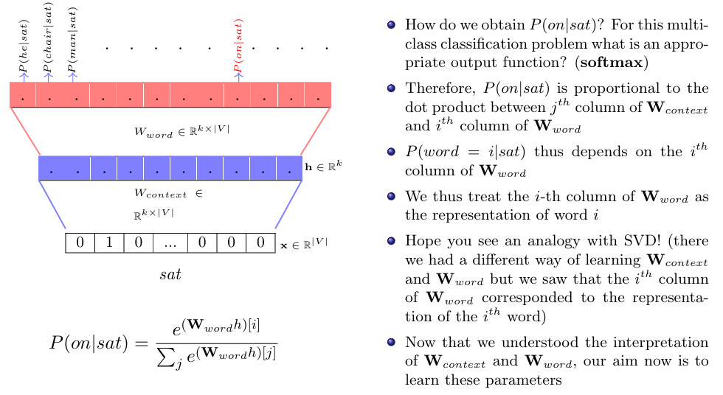
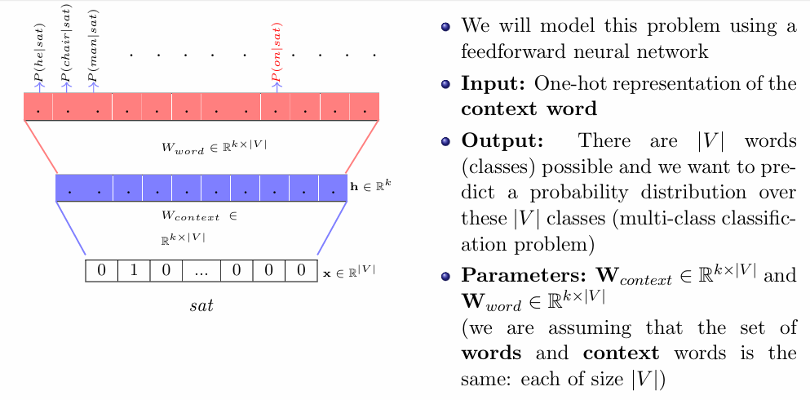
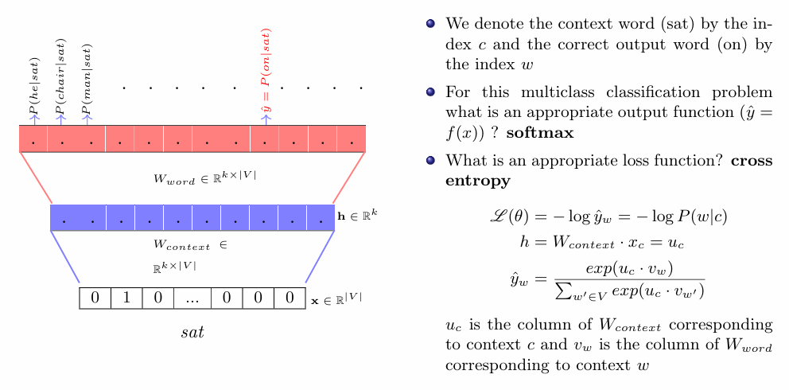
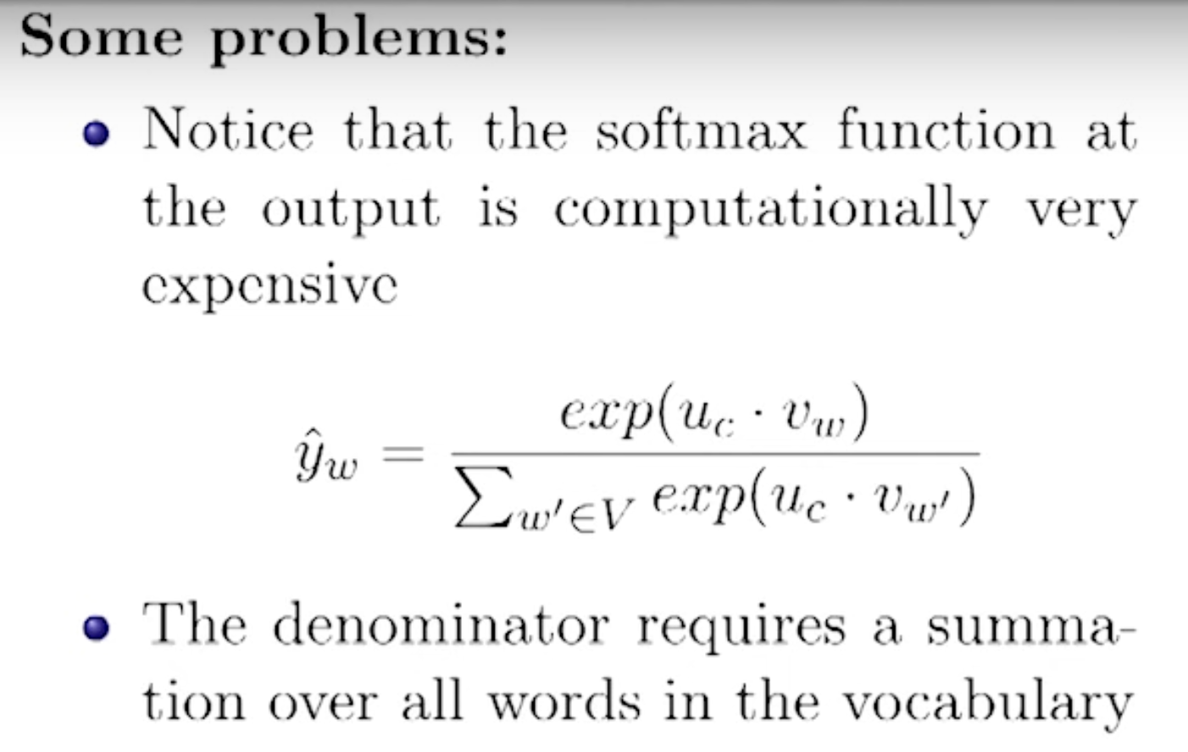
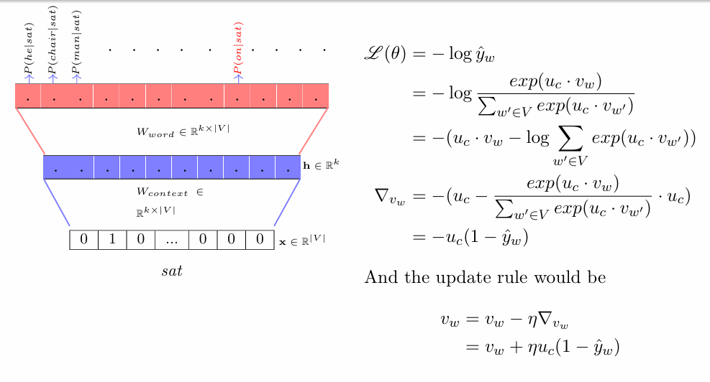
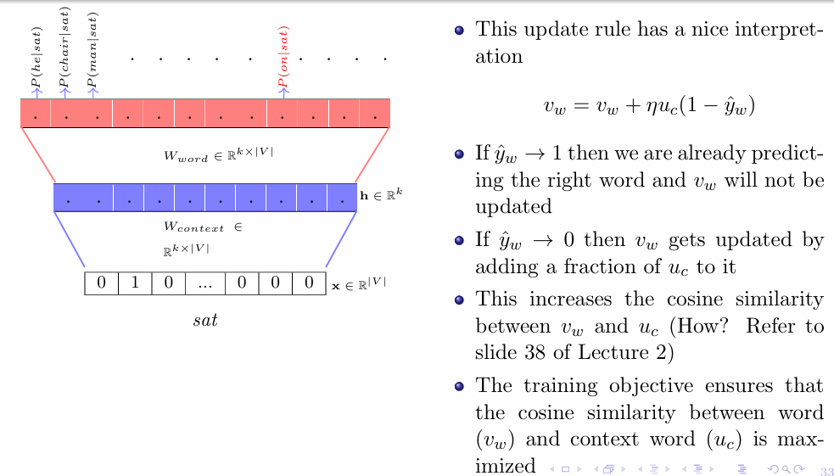
Count Based vs. Prediction Based Models
Prediction Based Model Working
Continuous Bag of Words Model
Limitations

Slide 7
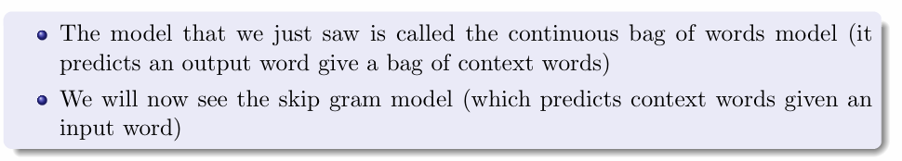
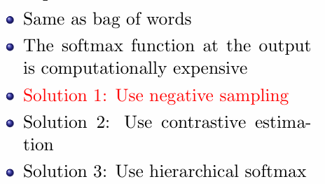
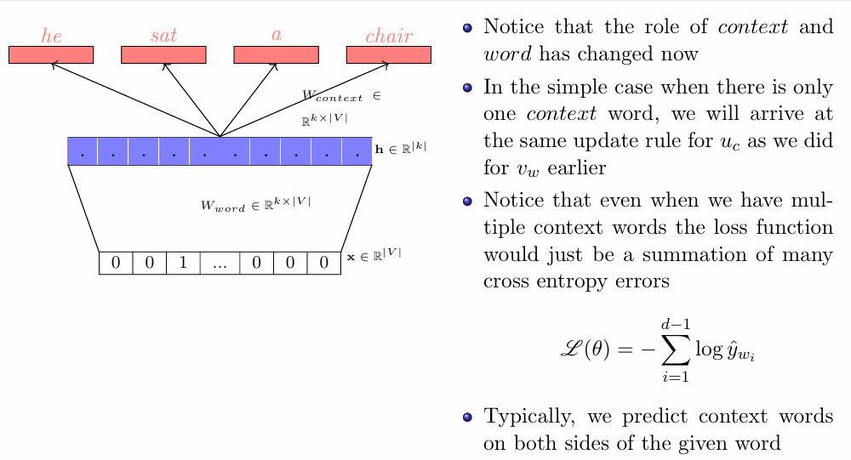
Skip-gram Model
Limitations

Slide 8
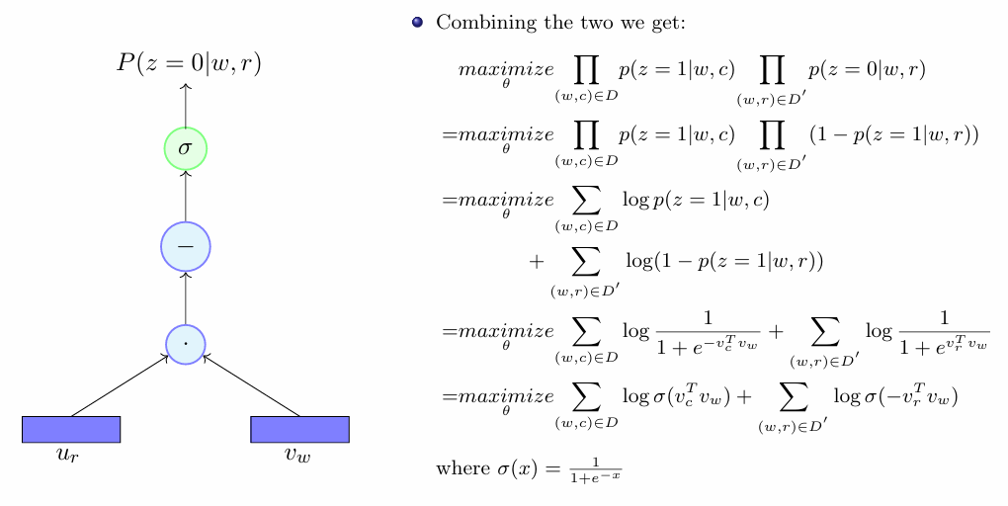
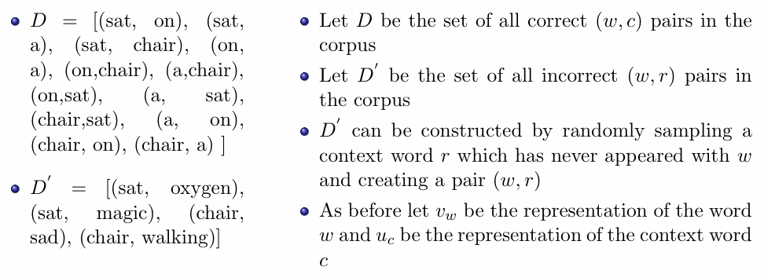
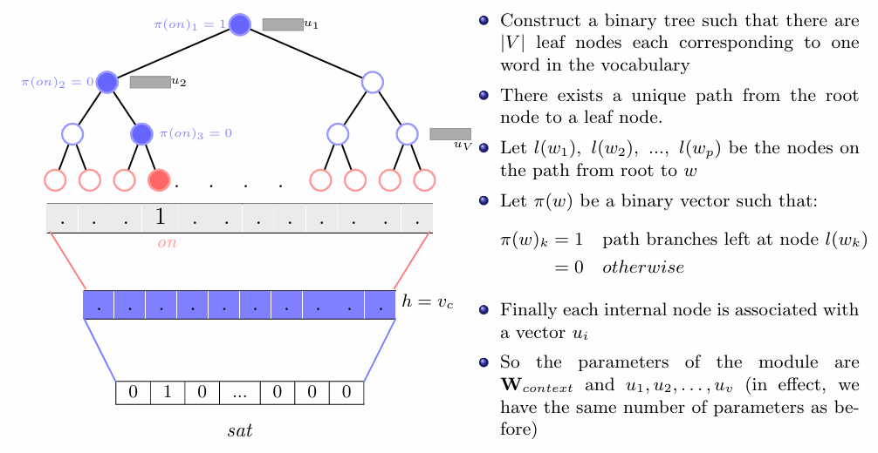
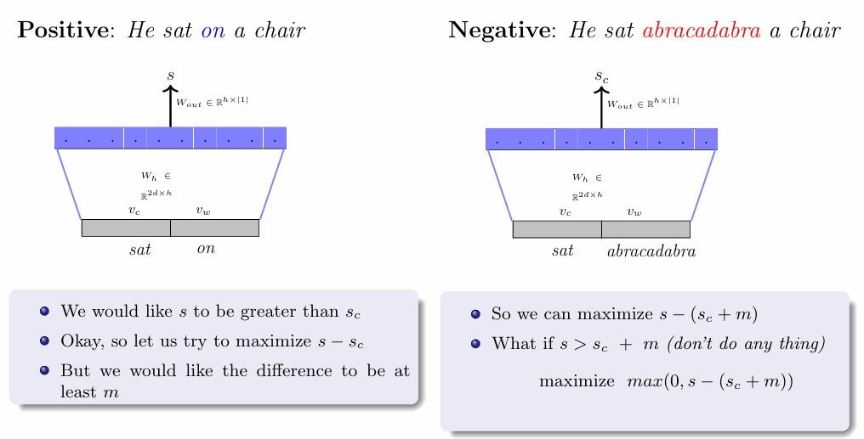
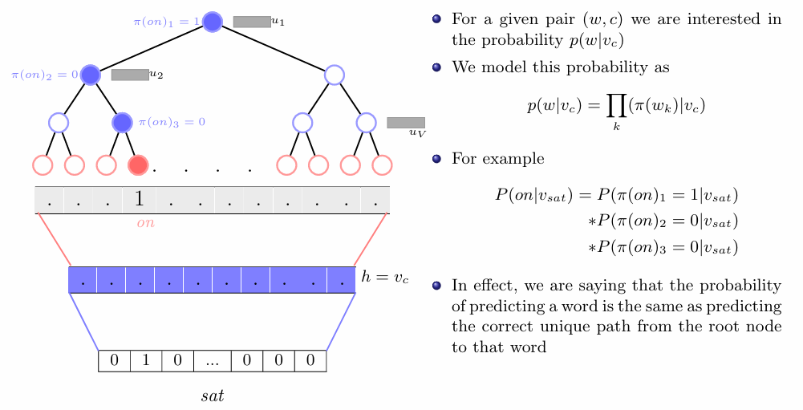
Negative Sampling
Hierarchical SoftMax
Contrastive Estimation

Slide 9
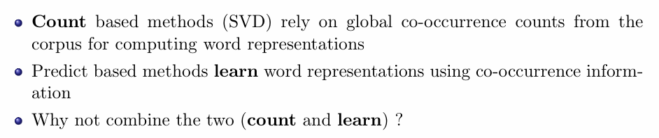
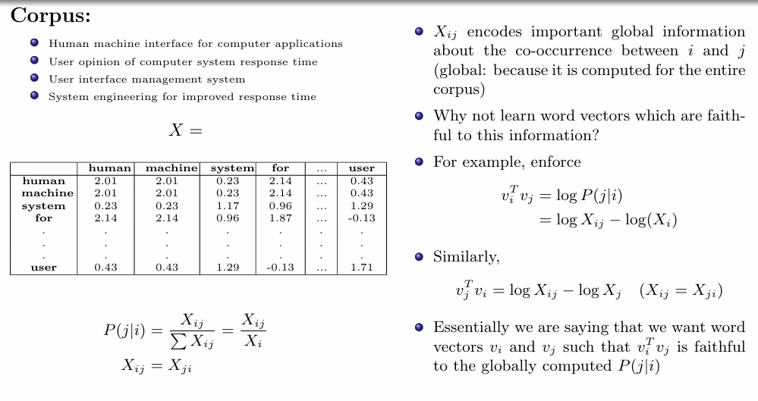
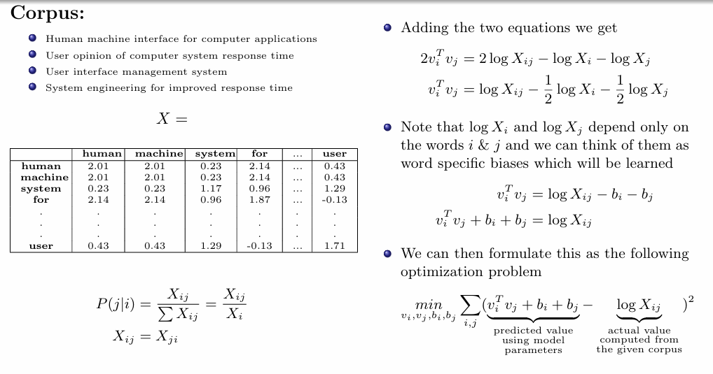
GloVe Representations

Slide 10
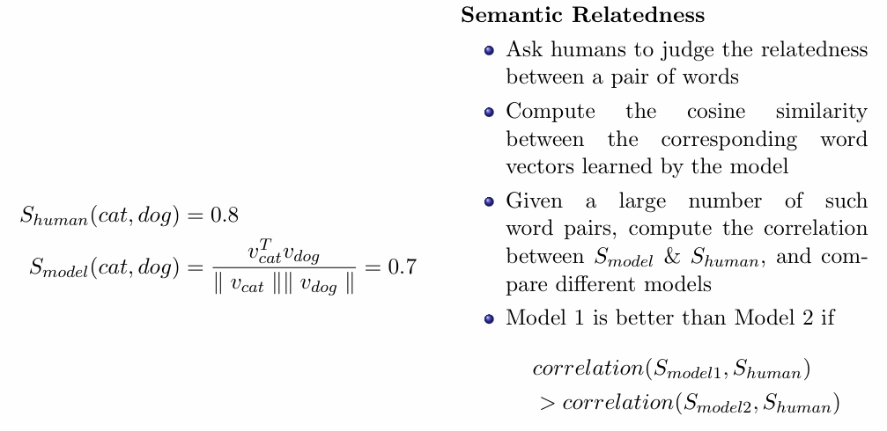
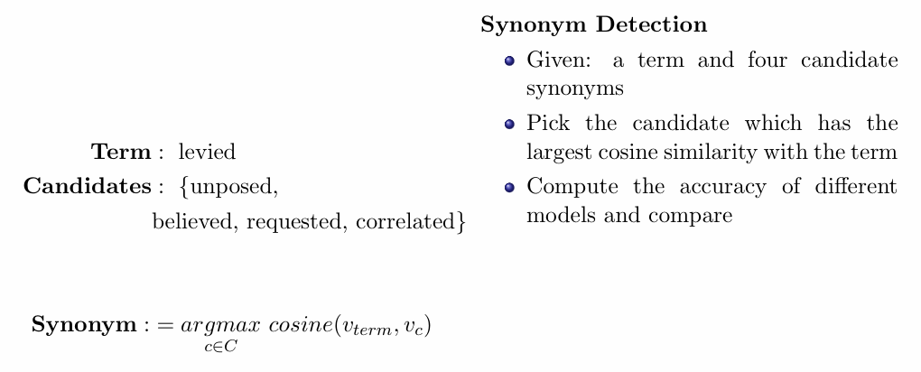
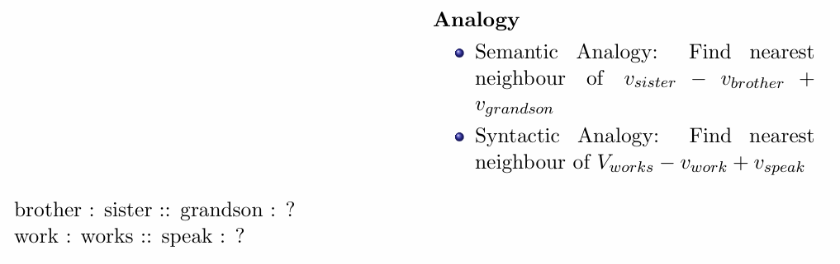
Evaluating Word Representations

Slide 11
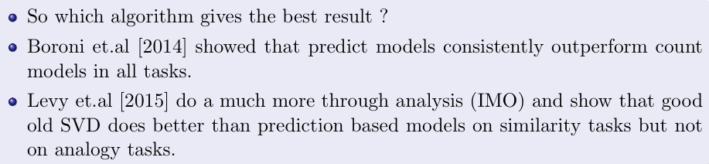
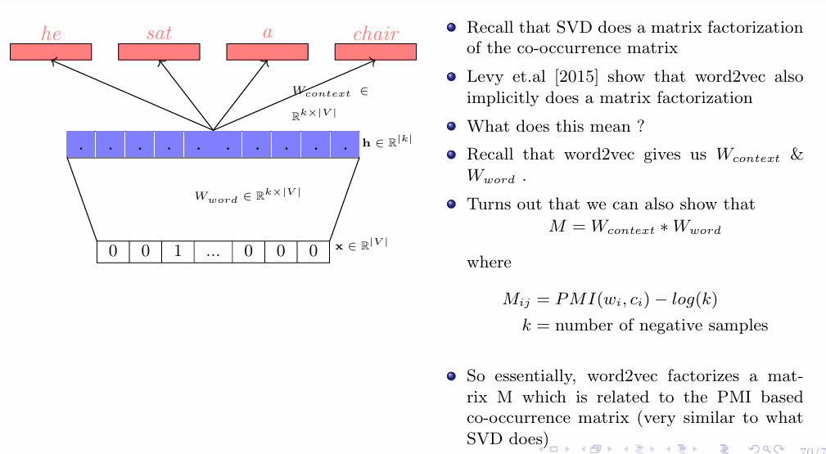
Count vs. Predict Models
Relation between SVD and word2vec

Slide 12
Topics on which Week 9 Assignment Questions are based
One-hot representations of words
Distributed Representation of words
SVD for learning Word Representation
Word2vec (CBOW and Skip-gram)
GloVe Representation
Count Based vs. Prediction Based Models

Slide 13
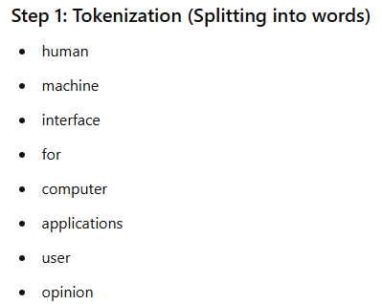
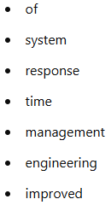
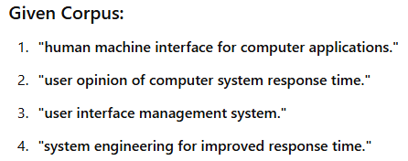
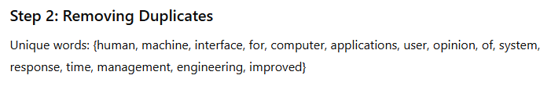
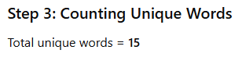
QUESTION 1
Consider the following corpus:
"human machine interface for computer applications. user opinion of computer system response time. user interface management system. system engineering for improved response time".
What is the size of the vocabulary of the above corpus?
13
14
15
16
SOLUTION 1
CORRECT ANSWER 1
c)

Slide 14
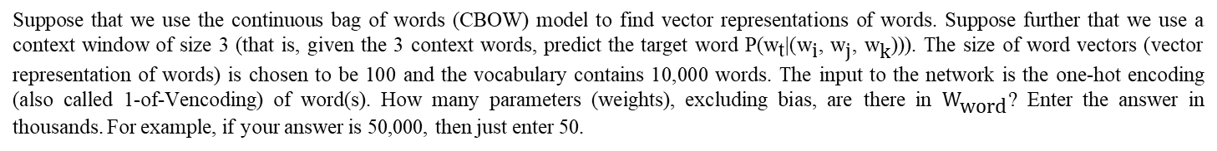
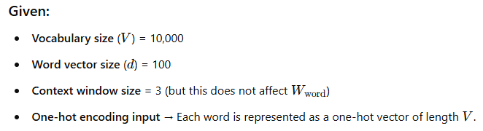
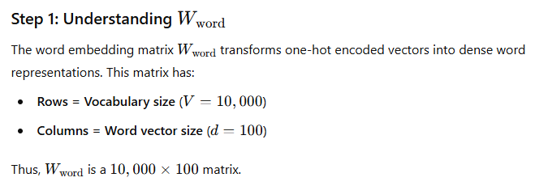
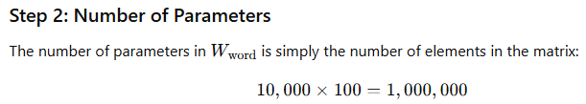
QUESTION 2
SOLUTION 2
CORRECT ANSWER 2
1000

Slide 15
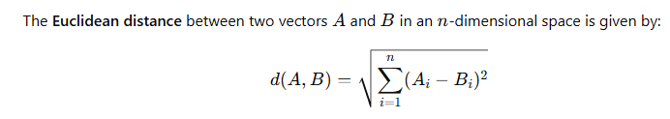
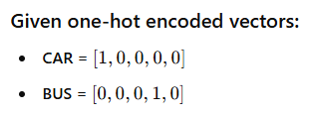


QUESTION 3
You are given the one hot representation of two words below:
CAR=[1,0,0,0,0], BUS=[0,0,0,1,0]
What is the Euclidean distance between CAR and BUS?
SOLUTION 3
CORRECT ANSWER 3
Range: 1.41 to 1.42

Slide 16




QUESTION 4
SOLUTION 4
CORRECT ANSWER 4
c)

Slide 17


QUESTION 5
Which of the following is an advantage of the CBOW model compared to the Skip-gram model?
It is faster to train
It requires less memory
It performs better on rare words
All of the above
SOLUTION 5
CORRECT ANSWER 5
a), b)

Slide 18



QUESTION 6
Which of the following is a disadvantage of one hot encoding?
It requires a large amount of memory to store the vectors
It can result in a high-dimensional sparse representation
It cannot capture the semantic similarity between words
All of the above
SOLUTION 6
CORRECT ANSWER 6
d)

Slide 19


QUESTION 7
Which of the following is an advantage of using the skip-gram method over the bag-of-words approach?
The skip-gram method is faster to train
The skip-gram method performs better on rare words
The bag-of-words approach is more accurate
The bag-of-words approach is better for short texts
SOLUTION 7
CORRECT ANSWER 7
b), d)

Slide 20




QUESTION 8
SOLUTION 8
CORRECT ANSWER 8
b)

Slide 21




QUESTION 9
SOLUTION 9
CORRECT ANSWER 9
a)

Slide 22



QUESTION 10
How does Hierarchical Softmax reduce the computational complexity of computing the softmax function?
It replaces the softmax function with a linear function
It uses a binary tree to approximate the softmax function
It uses a heuristic to compute the softmax function faster
It does not reduce the computational complexity of computing the softmax function
SOLUTION 10
CORRECT ANSWER 10
b)

